Slide 1
Before you begin
What is a "Question"?
What is a "Scientific Question"?
"Every scientific breakthrough begins with a question. We may not have all the answers at once, but maybe sharing questions and having conversations with others is a good place to start. - Dr. Jackie Oberst
125 questions: Exploration and discovery https://www.science.org/content/resource/125-questions-exploration-and-discovery

Slide 2

Before you begin
Academic research is the process of solving scientific problems
Your report (essay / article) is the answer to what you try to share

Slide 3
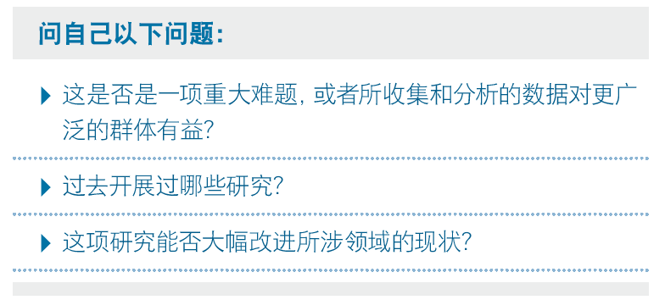
Before you begin

Slide 4

Before you begin
If I have seen further than others, it is by standing upon the shoulders of giants.
-- Isaac Newton

Slide 5
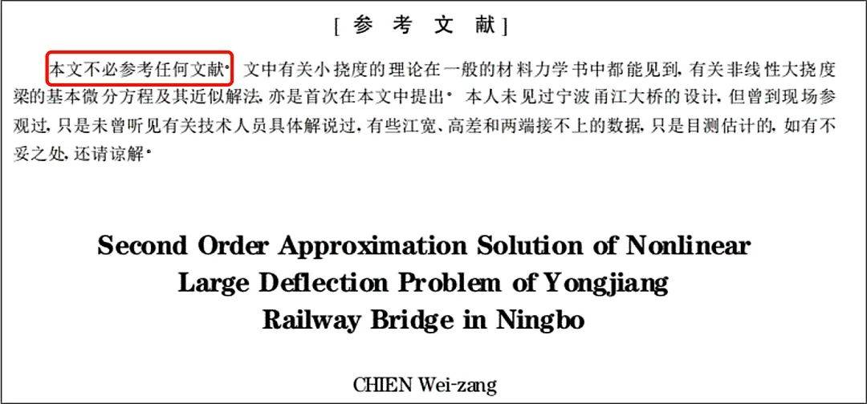
Unless ...
Notes:
好了，现在随着研究的深入，我已经看了海量的文献，成为了研究领域的懂王了，作为一个尾巴都快翘到天上去的青年科学家，我打算开始写论文了，这时候我又怎么在论文里证明自己看了这些文献呢？ 除非你能像他一样。。。

Slide 6
Guide to A Successful Literature Review 4 May 2023

Slide 7
Contents
What does the term "literature review" mean to you?
How to write one?
How to read papers and get to know a field?
How to get a useful paper?
How to cite sources?

Slide 8




What does the term "literature review" mean to you?
“You explain and describe the recent theories and something like that. I don’t know, man. I guess I talk about specific details and things. But how far do I go? I mean, that could take forever.”
“I don’t know. I have no idea about the structure. It’s a synthesis and summary, I know that.”
“You basically read the basic stuff, the basic points, finding out about the research. Then, essentially synthesizing the paper in a successful manner.”
“You summarize the literature and how it contributes. If the arguments are contrasting , then you write how they contrast. So, I guess it’s a summary of everything that’s been said.”

Slide 9
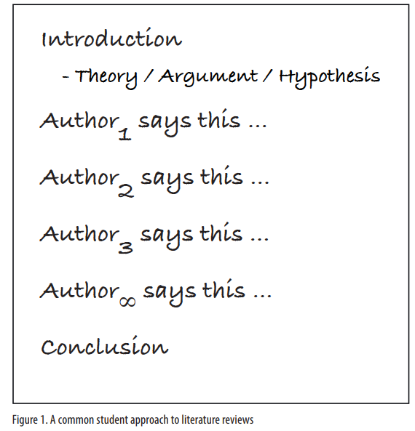


Summarize
Synthesize

Slide 10
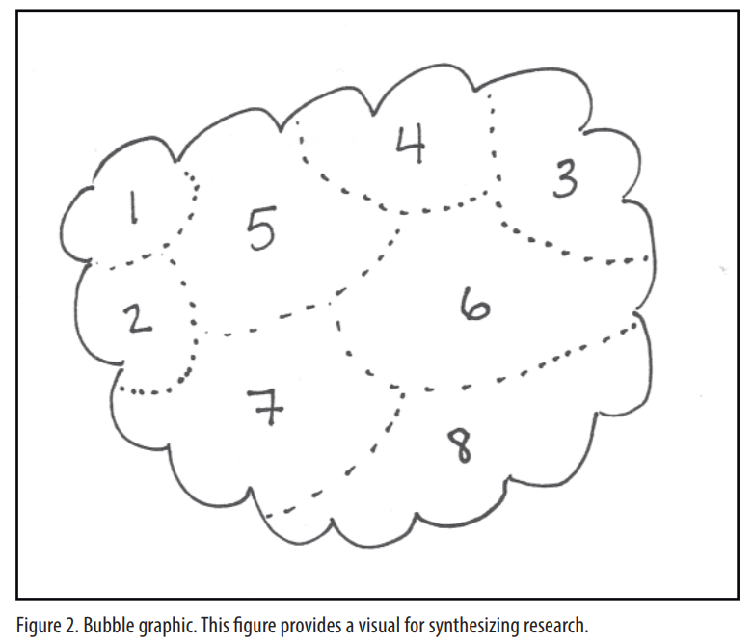

Slide 11
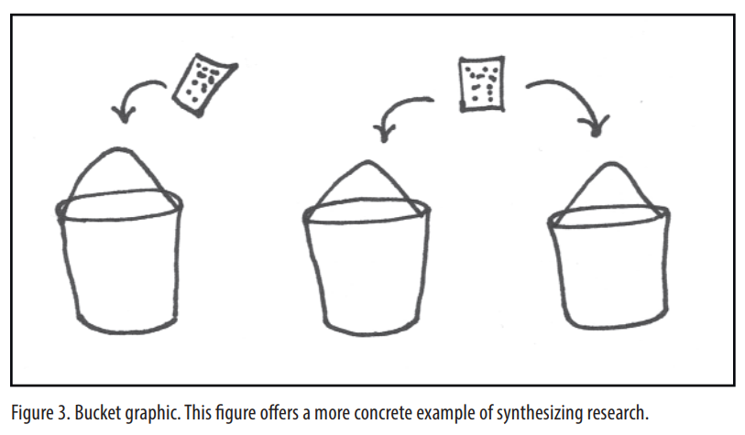
theme 1
theme 2
theme 3
Collect sources and organize them

Slide 12
What is Democracy?
The study of democracy and democratization has dominated the field of comparative politics. Scholars have varied in their approach of how to define and measure democracy ; however, the most recognized definition of democracy belongs to Schumpeter (1976) which states that democracy "is that institutional arrangement for arriving at political decisions in which individuals acquire the power to decide by means of a competitive struggle for the people's vote" (269). Dahl's (1971) notion of democracy poses an ideal form of the government, unachievable by today's standards. In sum, defining democracy, although important, presents a variety of challenges.

Slide 13
Various measures of democracy have been posited by scholars. Przeworski, Alverez, Cheibub, and Limongi (2000) argue that democracy is a dichotomous variable, existing only if (1) a chief executive is elected; (2) the legislature is elected; (3) there is more than one political party ; and (4) a change in power has occurred. Other scholars, however, assert that universal and equal suffrage are essential in the conceptualization of democracy (Rueschemeyer, Stephens, and Stephens 1992). This dichotomous notion of democracy, although useful in distinguishing countries from authoritarian regimes, ignores the transitionary nature of democratic governance (Lipset 2006). Marshall and Jagger's (2003) Polity IV measure consider the progressive nature of democracy, while other scholars utilize a measure of democratic political rights (Freedom House 2005). The choice of measure, however, strictly depends on the questions being asked.

Slide 14
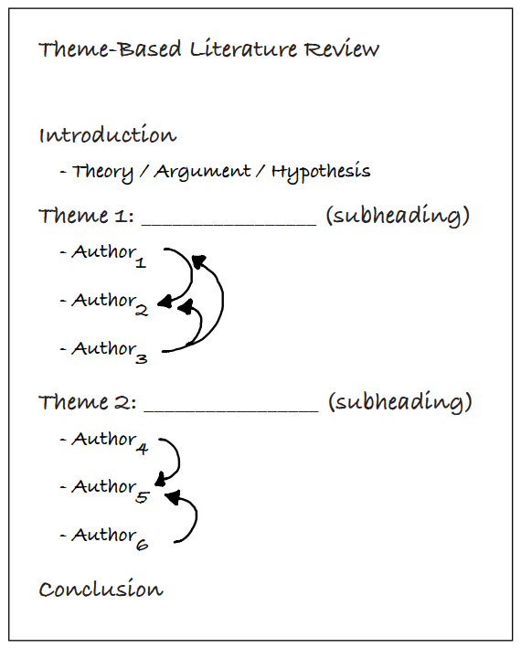
Idea-driven
Join a conversation
Disagreement?
Another approach?
……

Slide 15
How is literature review defined?
a combination of analysis, synthesis, and summary
categories / order / process …
 | Examples
Theoretical | A Theoretical Review of Bullying: Can It Be Eliminated?
Chronological | How Language Teaching Methodology Has Developed

Slide 16


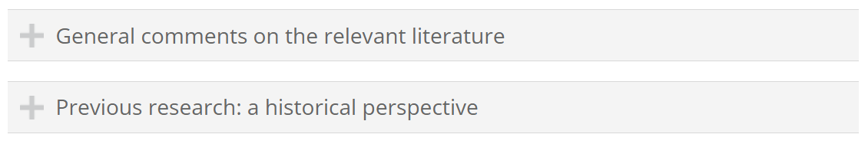
How to write
The list goes on …
https://www.phrasebank.manchester.ac.uk/referring-to-sources/

Slide 17
How to write
Read a lot
Write a lot
Feedback
Social support
Keep calm and work hard ☺
Make mistakes!
Ask questions!

Slide 18
Read papers and get to know a field

Slide 19
How many of you have read a research article?
How many of you have read a research article from the beginning to the end?

Slide 20

How to read articles?
Review article (综述类文章)
Keywords:
review article, schoo life, adolescence

Slide 21
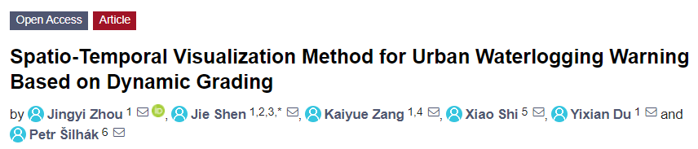
How to read articles?
Journal article (学术期刊)
Doctoral thesis (博士学位论文)

Slide 22
How to read articles?
qualitative research (定性研究)
Theoretical Background / Literature Review
Other areas of interest:
* Methodology (研究方法)
* Reference List
…
Title & Abstract (摘要)
Results & Discussion
tables & graphs & figures
quantitative research (定量研究)

Slide 23
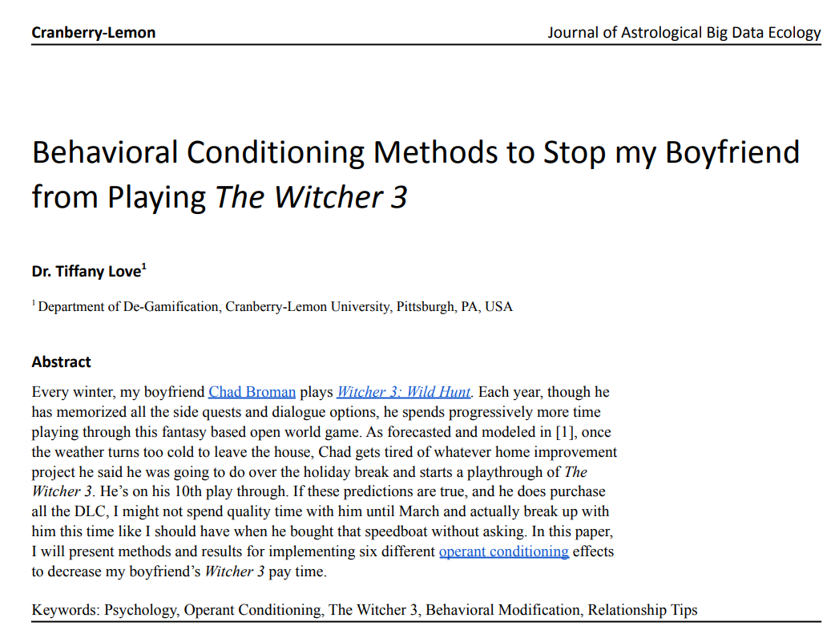
How do we read an article?

Slide 24

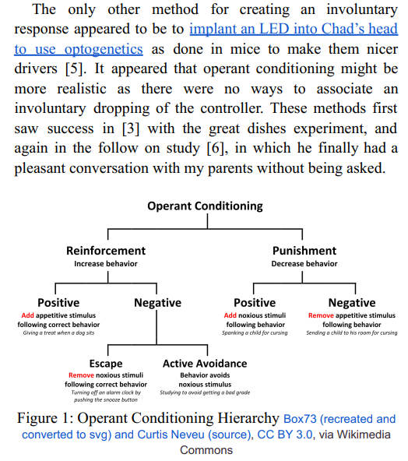

Slide 25
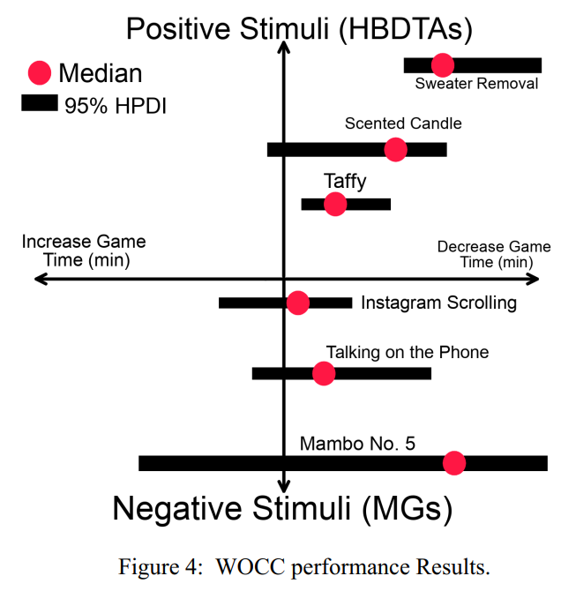
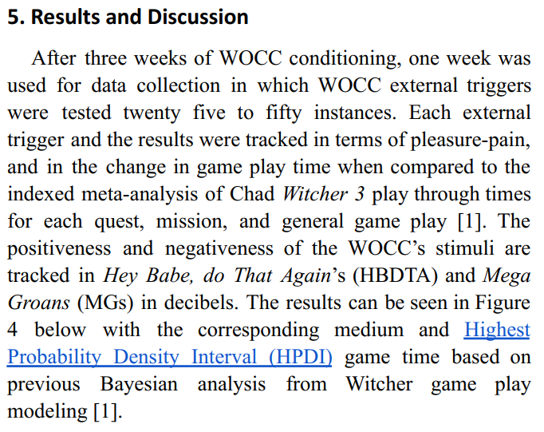

Slide 26


Slide 27
How to get a useful paper

Slide 28
Types of literature
普通图书
论文集、会议录 - Conference article
报告
学位论文 - Thesis
专利文献 - Patent
标准文献 - Standard
专著中析出的文献
期刊中析出的文献 - Journal article (学术期刊)
报纸中析出的文献
电子资源

Slide 29
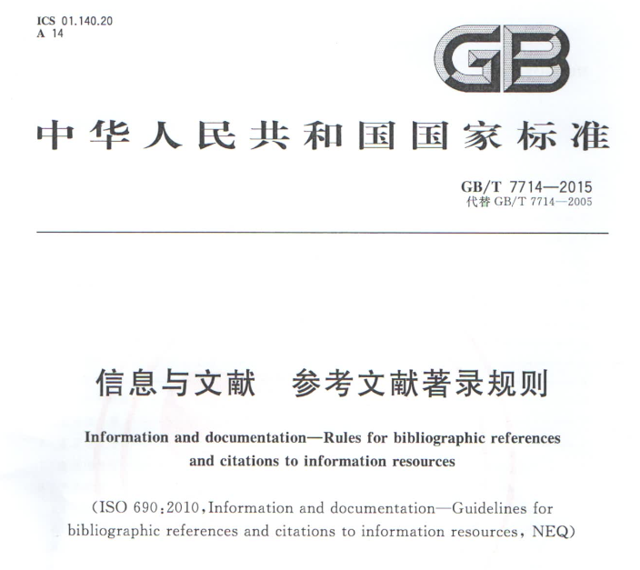
Types of literature :: Standard

Slide 30
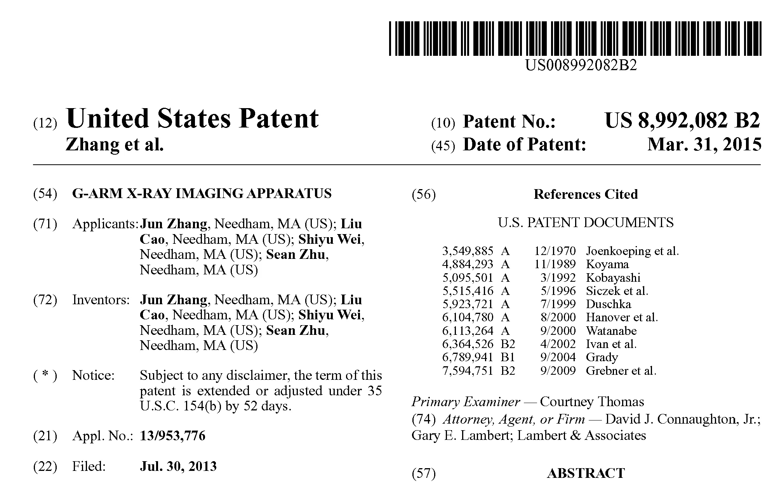
Types of literature :: Patent

Slide 31
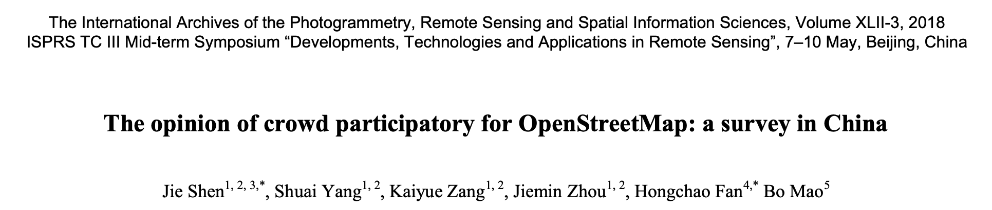
Types of literature :: Article
Journal article
Conference article

Slide 32
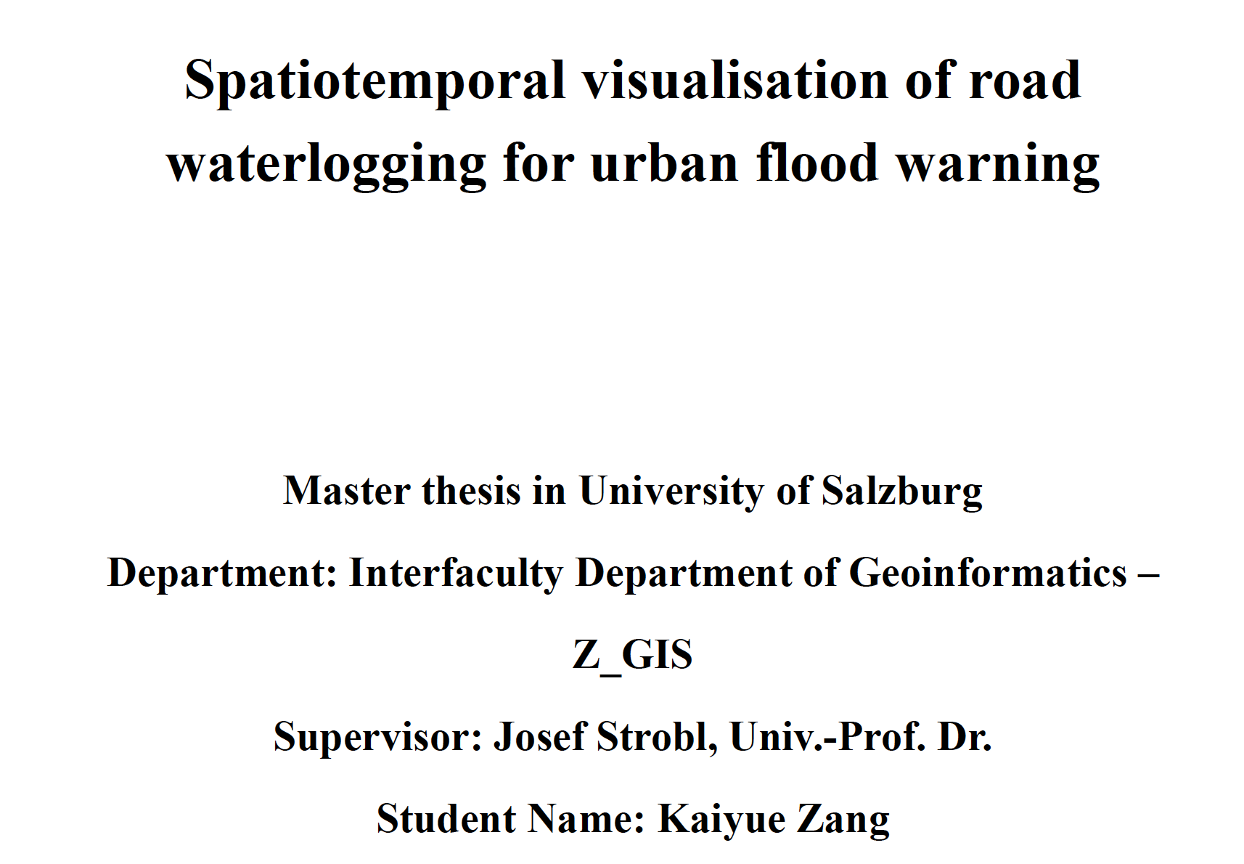
Types of literature :: Thesis

Slide 33

Where to find it?
Search Engine
Google
Bing
Baidu
Yahoo

Slide 34






Where to find it?
Academic index platform / Publisher's website

Slide 35



Where to find it?
Scholar platform
Google Scholar
scholar.google.com
百度学术
xueshu.baidu.com
中国知网
www.cnki.net

Slide 36
How to find it?
Step 1: Set your Keywords

Slide 37
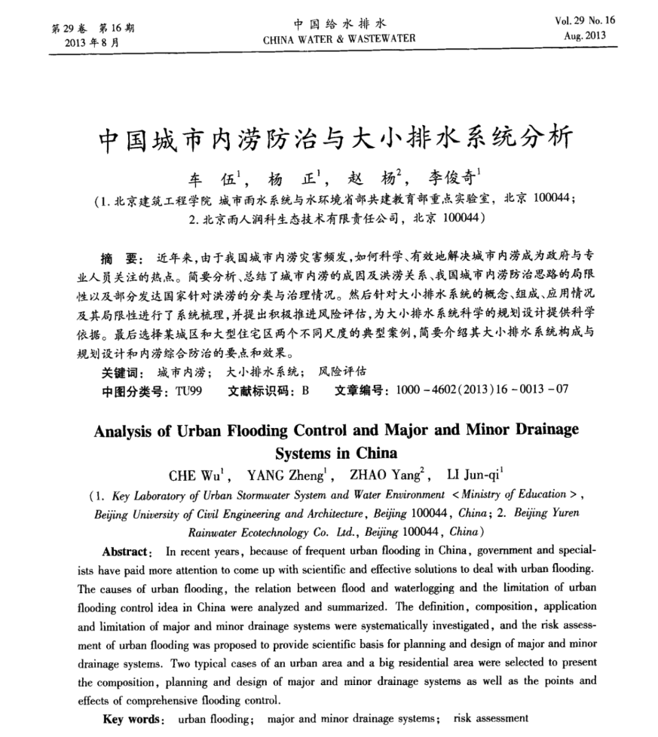

Slide 39
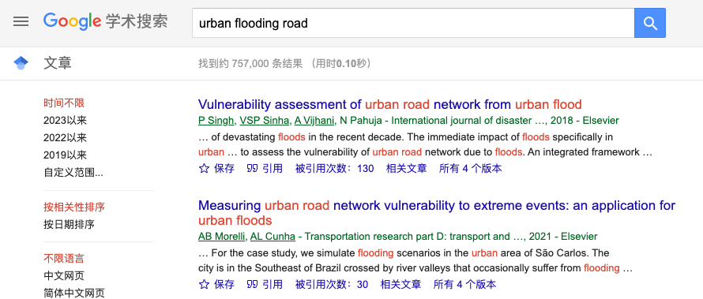

Slide 40

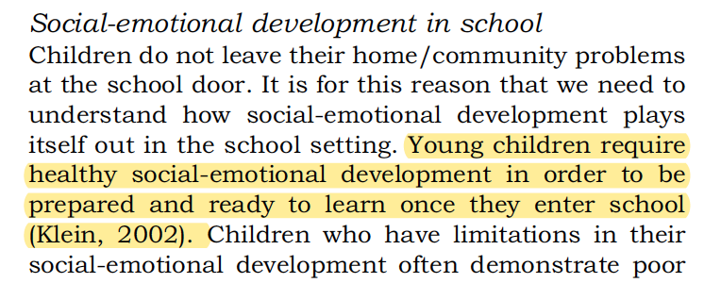
How to find it?
Step 2: The reference from references
page 34,

Slide 41
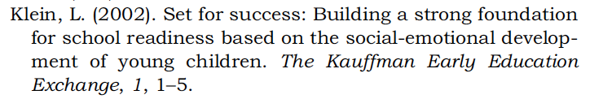
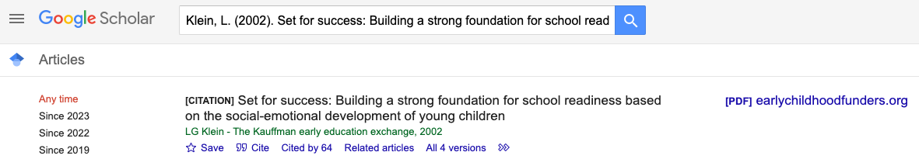


Slide 42
The way to access
Onilne website:
Just write down its URL(I mean, link address)
Other materials:
Hoho, great challenge for you ...
Maybe not free...
Maybe need a spacial acount...

Slide 43
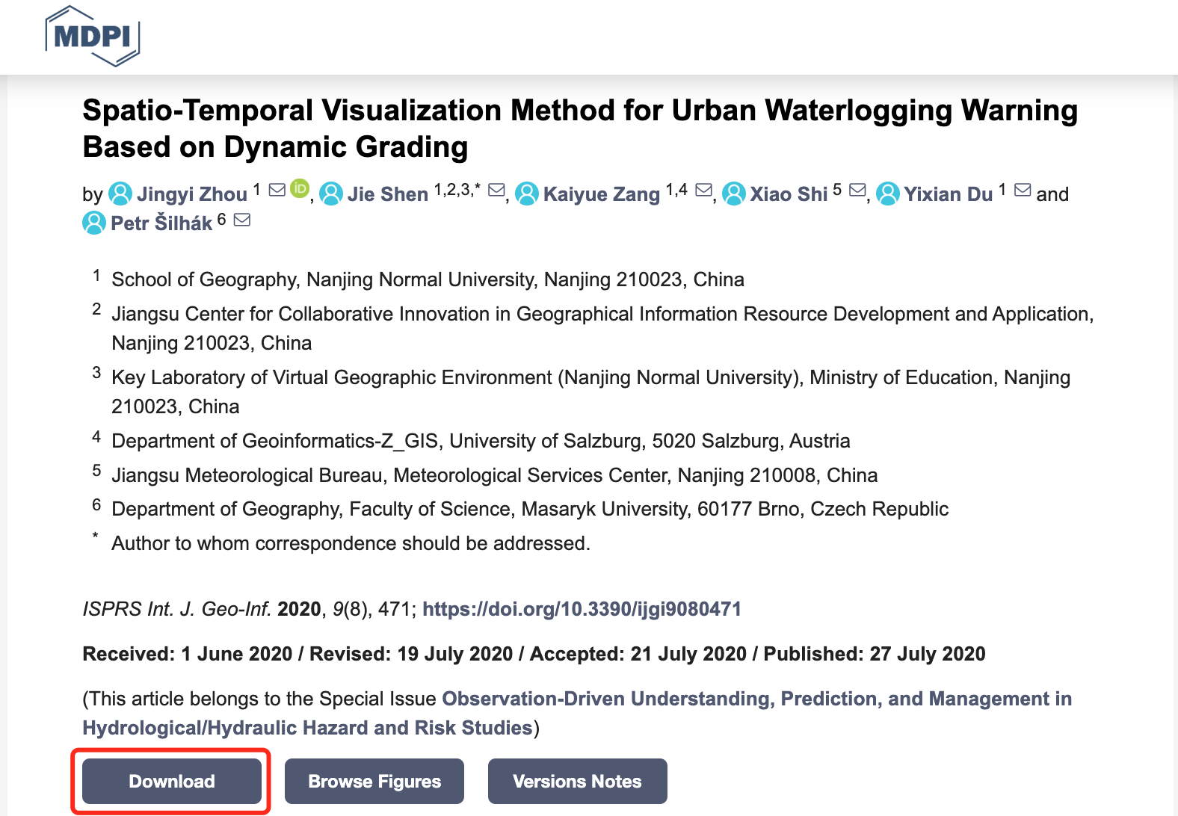
Download by offical source

Slide 44
Download by "special" source
Google scholar / 百度学术
Research Gate
Sci-Hub
Sent an E-mail to Author
Go to a public library
Buy a e-copy from Taobao →_→

Slide 45
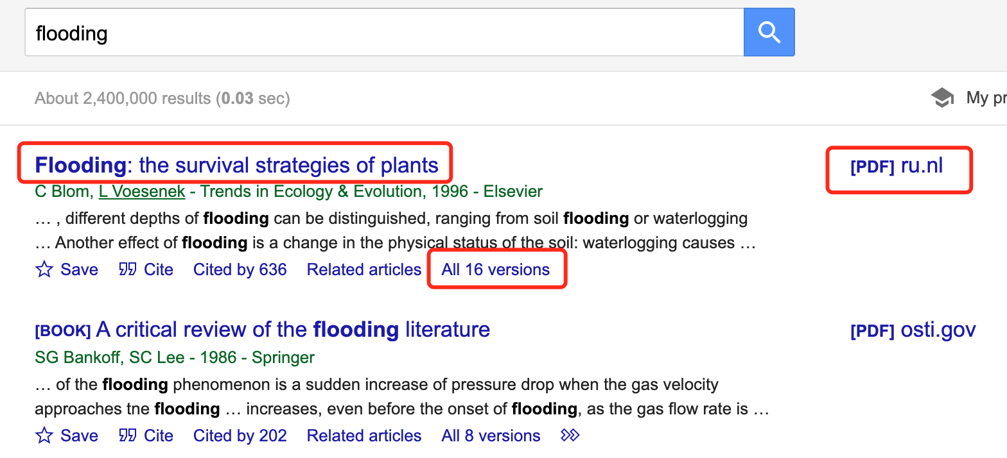
Google Scholar

Slide 46
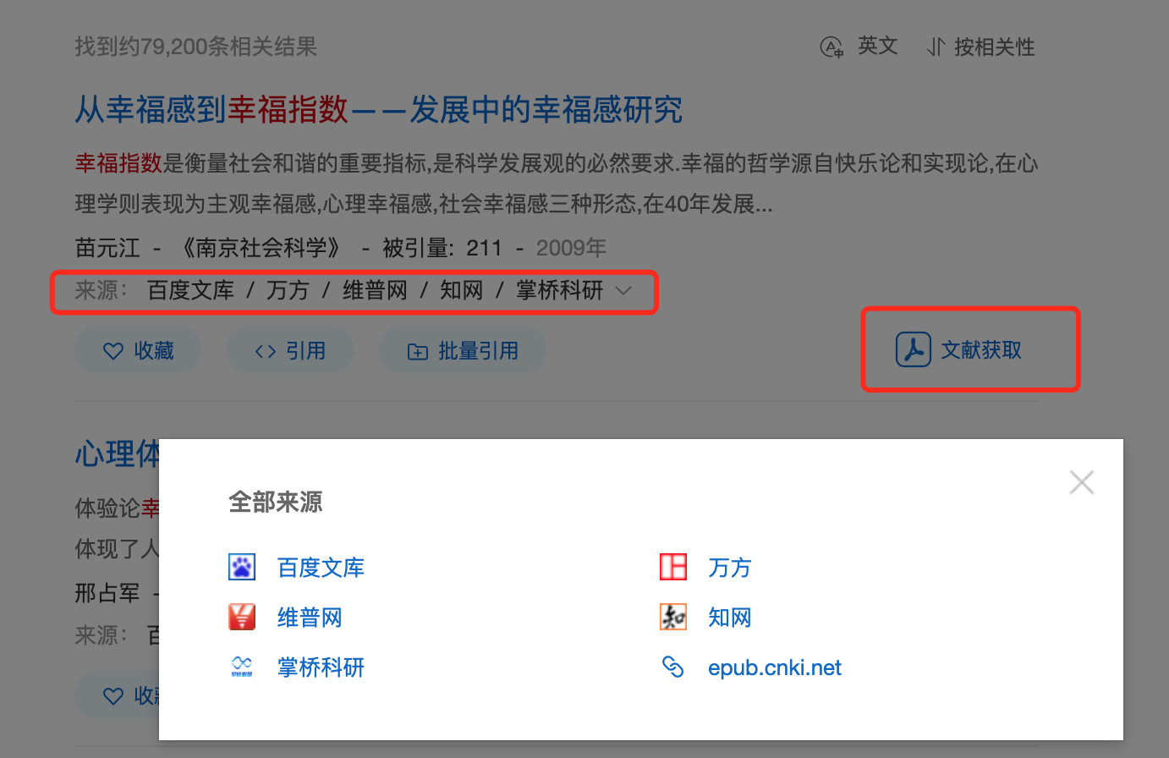
百度学术

Slide 47

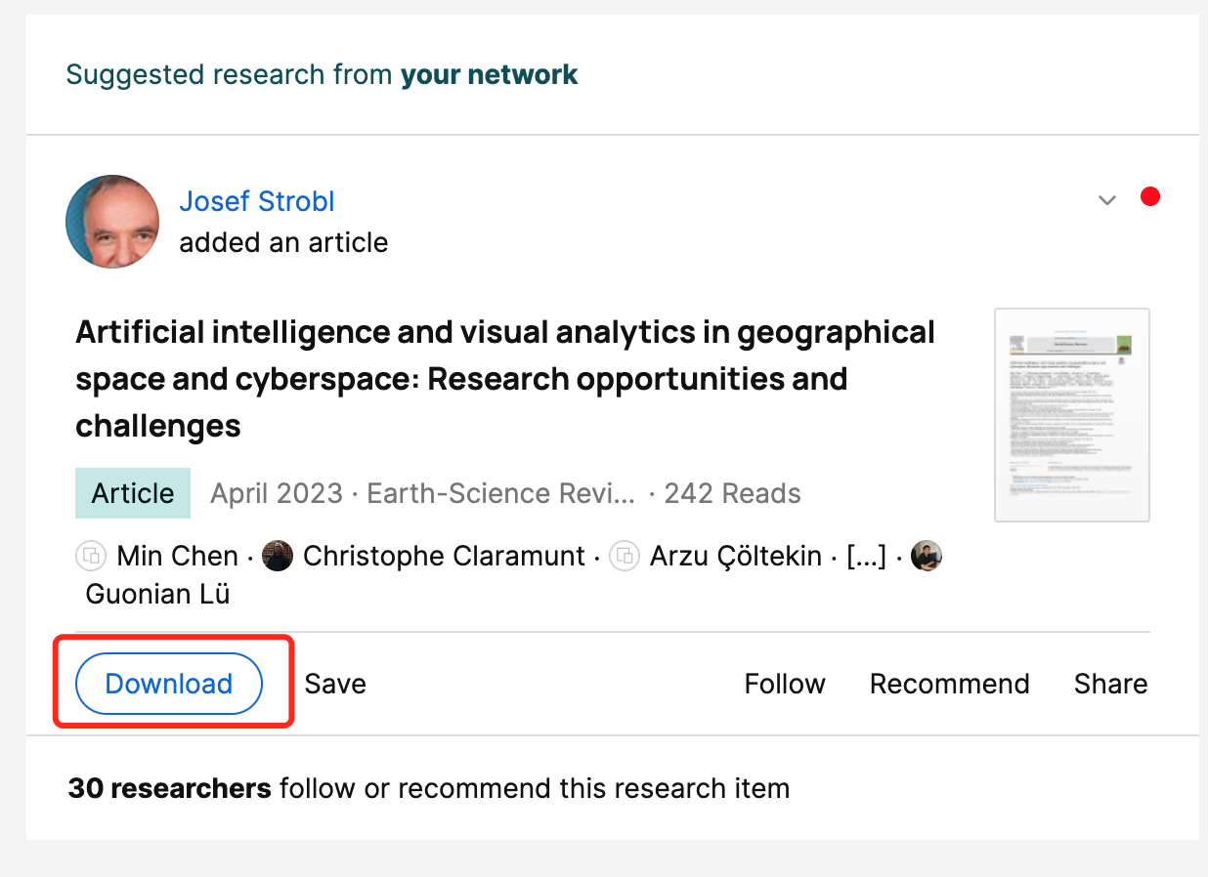
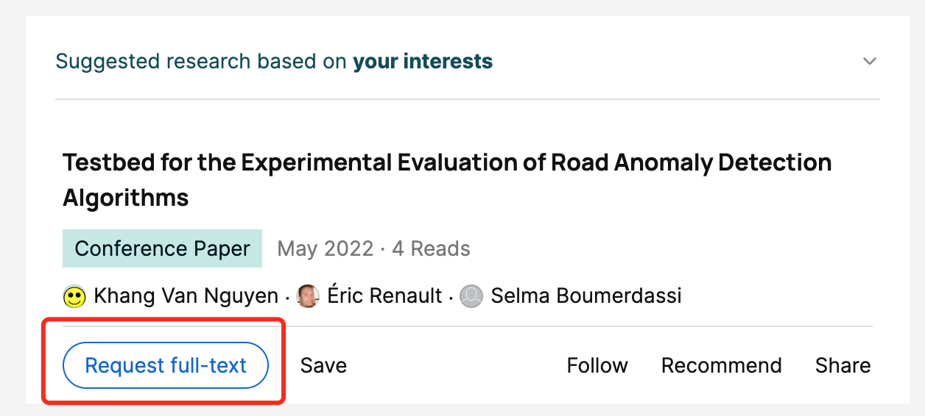
ResearchGate

Slide 48

Sci-Hub

Slide 49
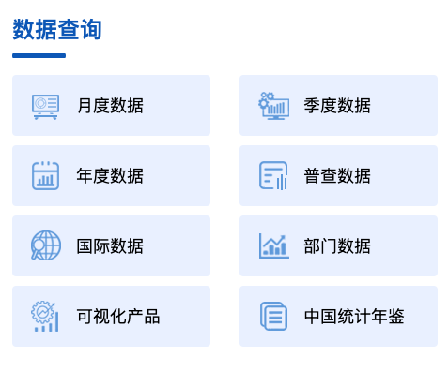
You may also need some data
Statistical data
世界银行 经济、人口等 https://data.worldbank.org/
联合国儿童基金会数据库 https://data.unicef.org/
中国国家统计局
http://www.stats.gov.cn/

Slide 50
You may also need some data
Geo-data
标准地图服务系统 - 国家自然资源部的官方合规地图，中英文均有，但只有成品地图无法编辑
http://bzdt.ch.mnr.gov.cn/index.html
阿里云数据可视化平台，有行政边界
http://datav.aliyun.com/portal/school/atlas/area_selector
Wanna see more?
【腾讯文档】地图资源 https://docs.qq.com/doc/DUlVzVU9seXBJdnFD

Slide 51
How to cite sources

Slide 52
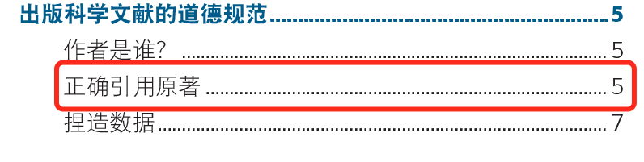
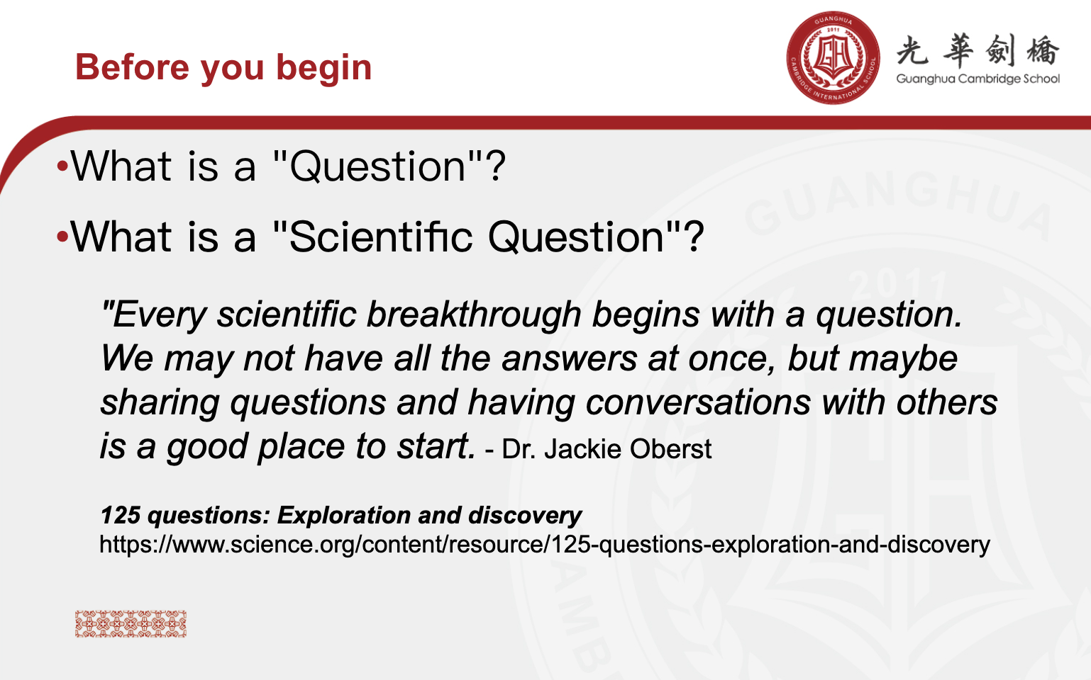
Cite the references

Slide 53
Citation style
著者-出版年制
Author-date style

Slide 54
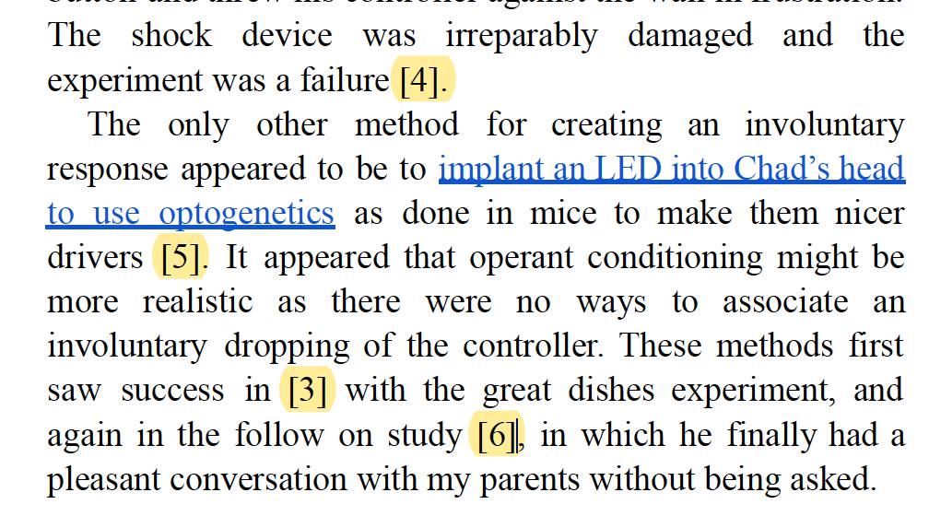
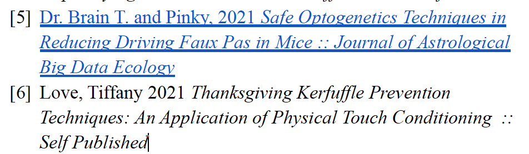
Citation style
顺序编码制
Numberred Style
zd

Slide 55
Now, you can try your best for typing your references ...
But it looks so silly @_@
Why not use modern tchnology?

Slide 56



Reference Manage Software
Mendely
Endnote
Zotero
https://www.mendeley.com/guides

Slide 57

Reference Management Software
You need "Software + Word Plug-in"

Slide 58
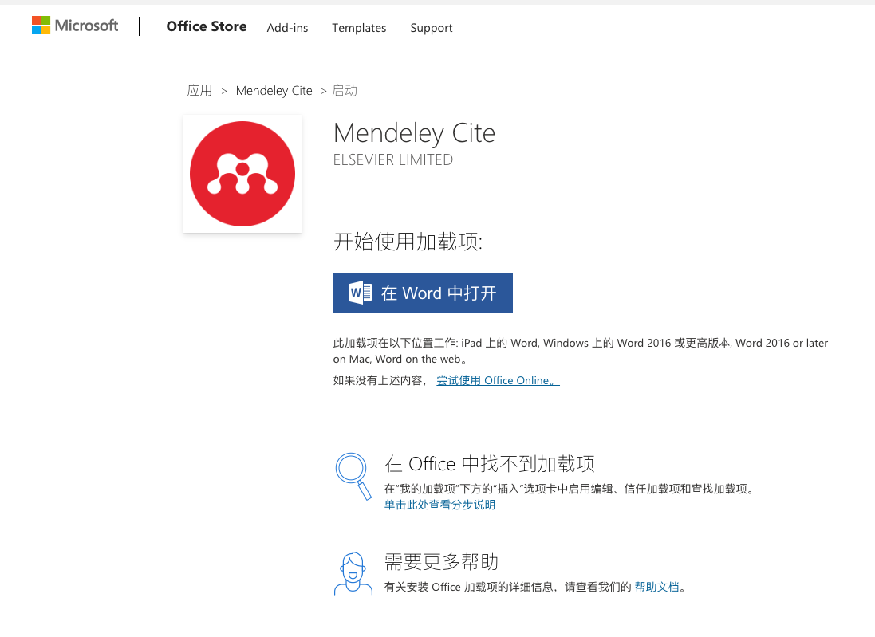

Slide 59
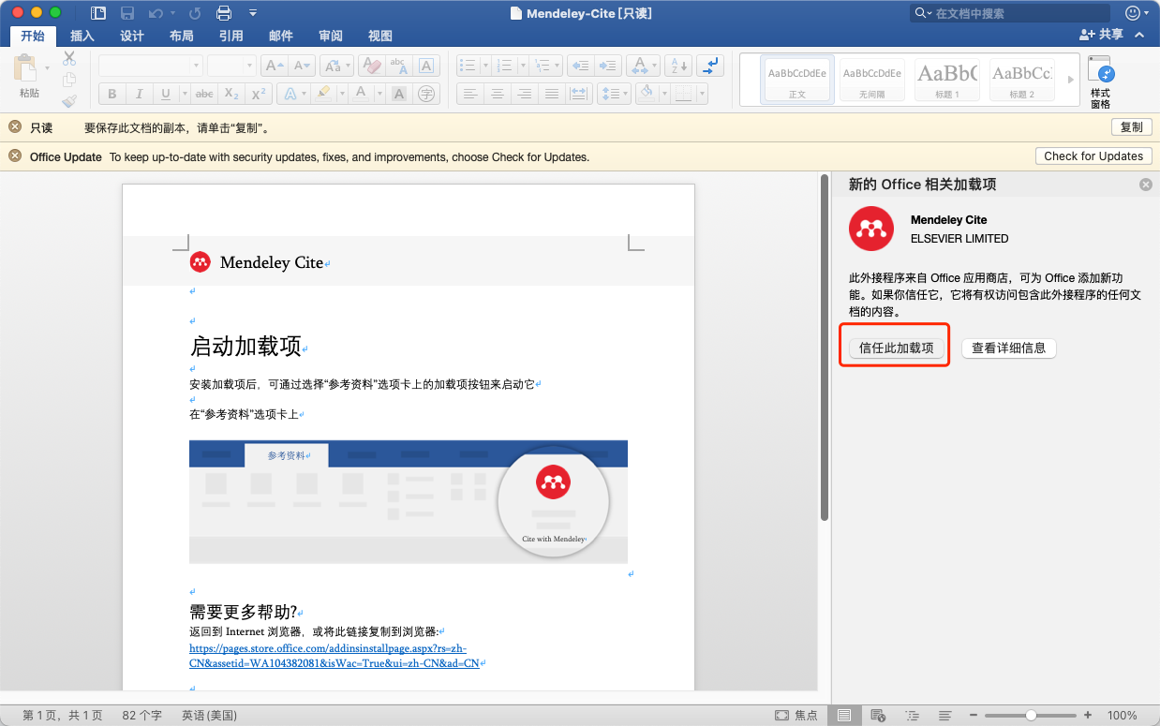

Slide 60
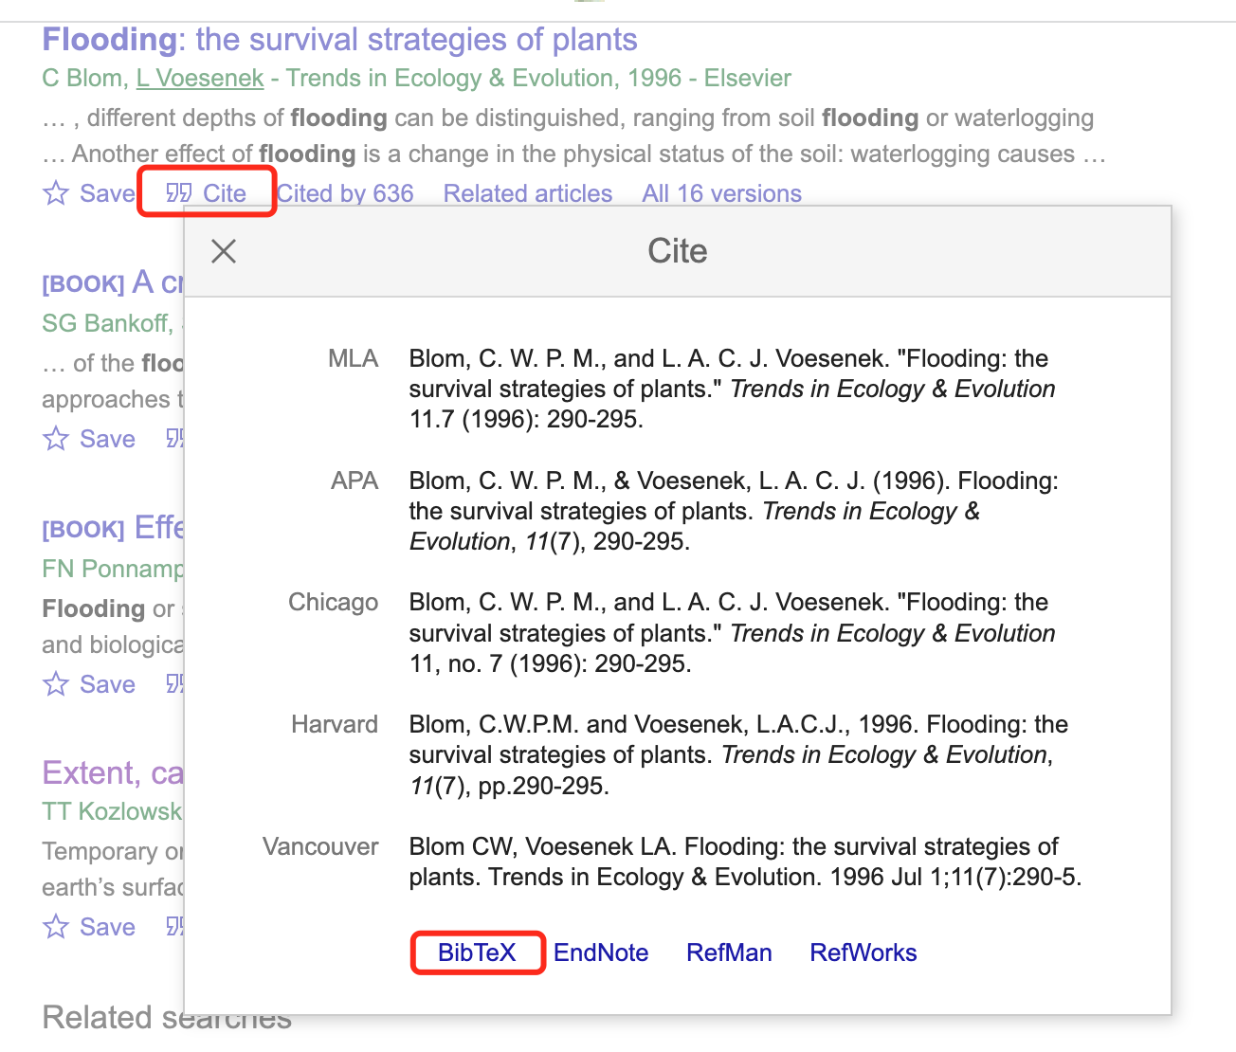

Slide 61
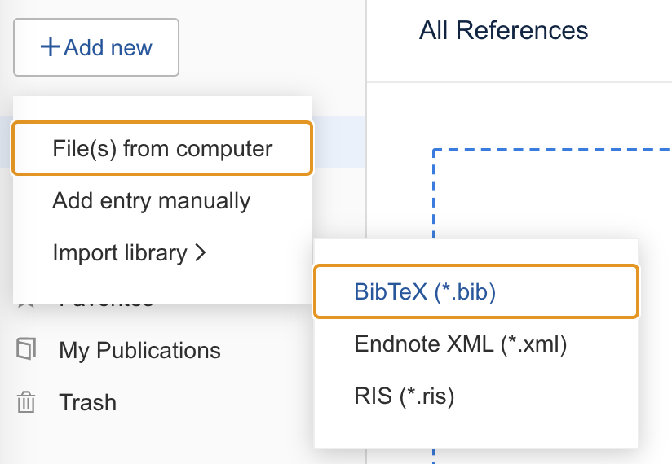

Slide 62
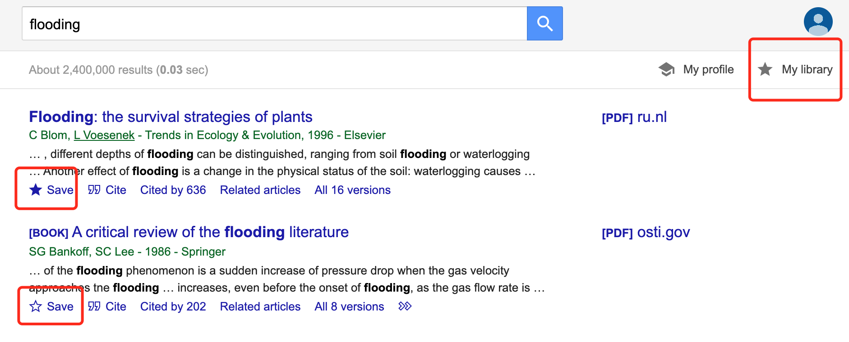

Slide 63
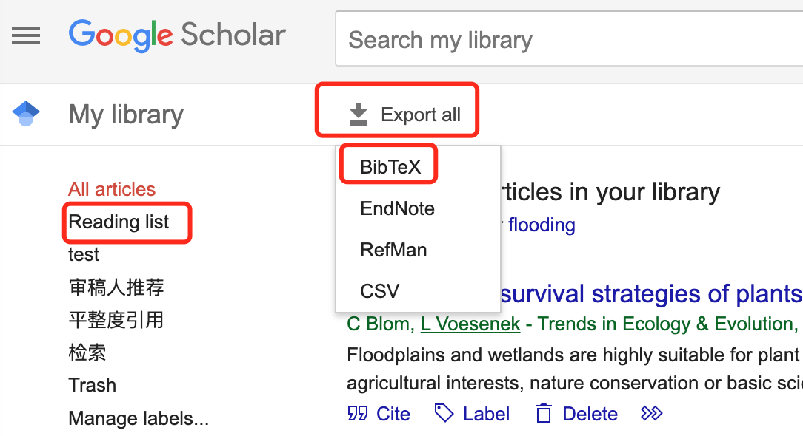

Slide 64
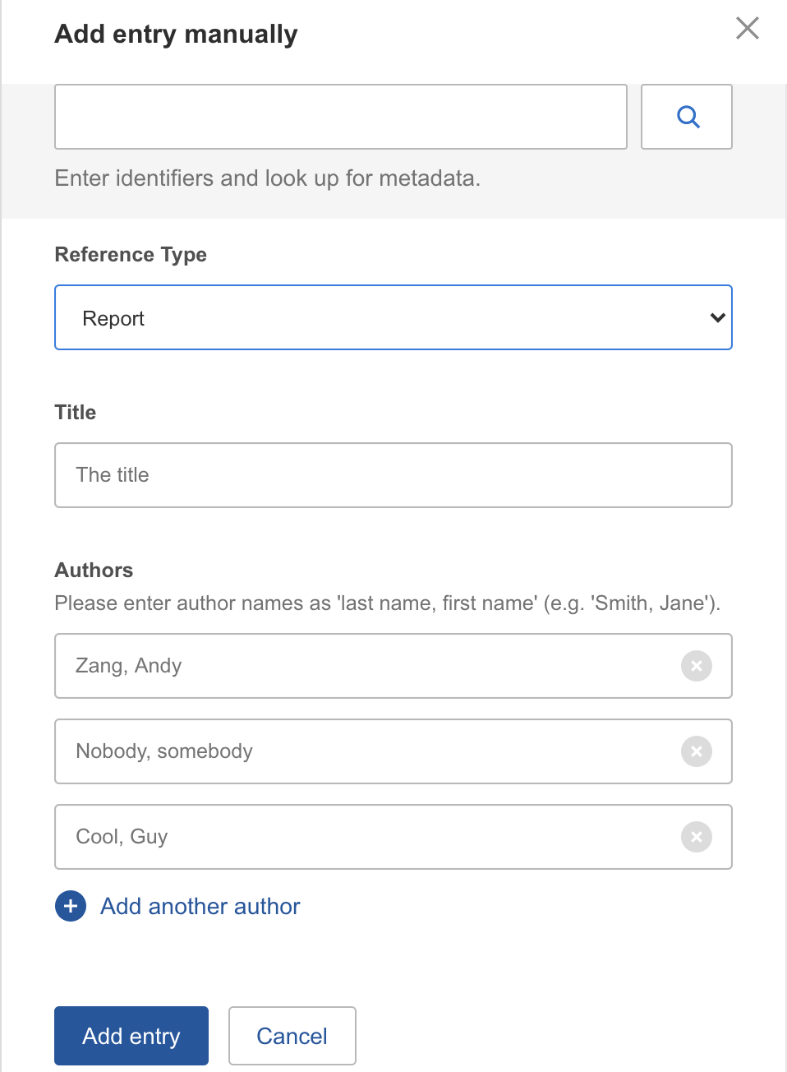

Slide 65


Slide 66
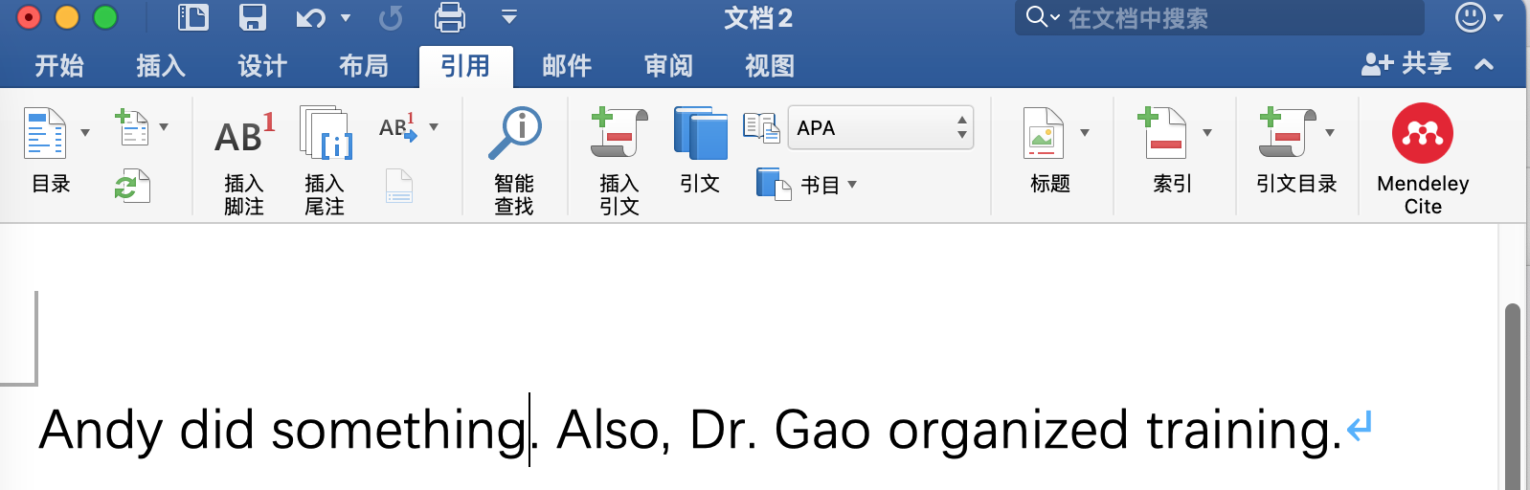

Slide 67
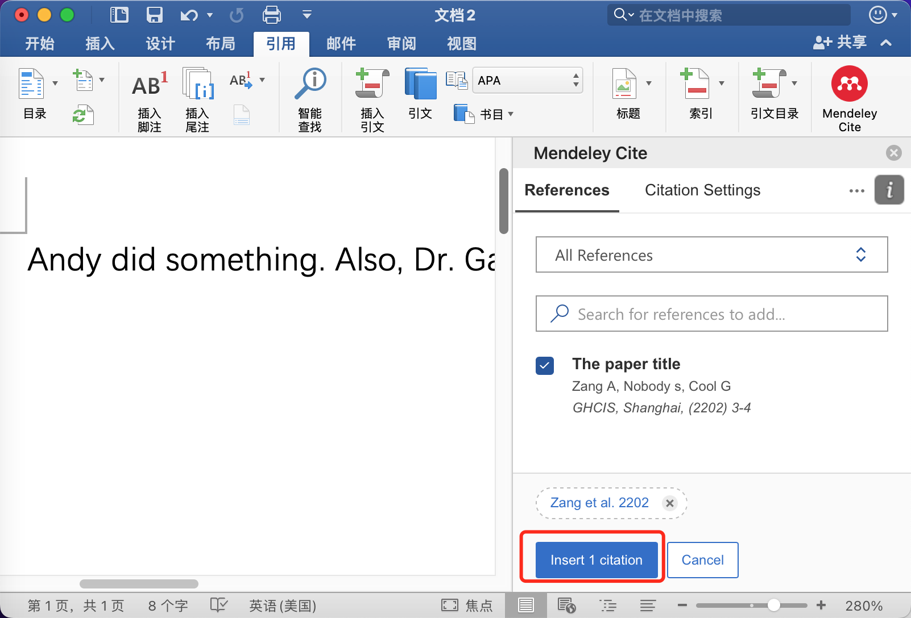

Slide 68
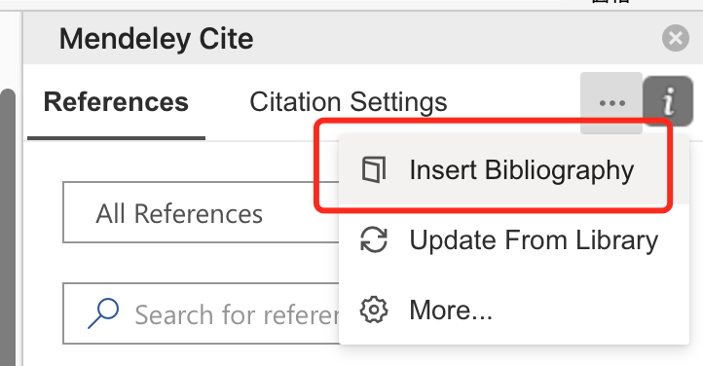

Slide 69
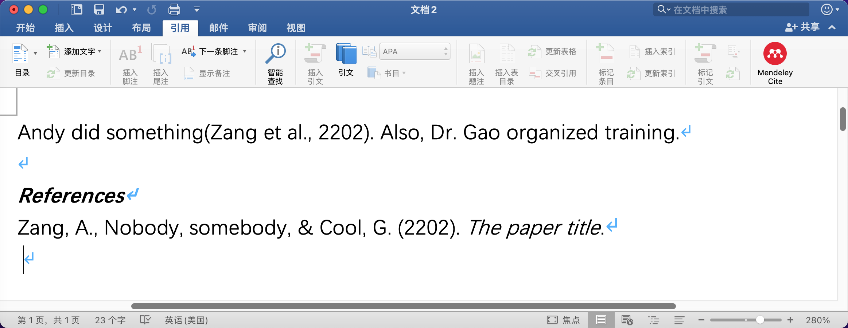

Slide 70
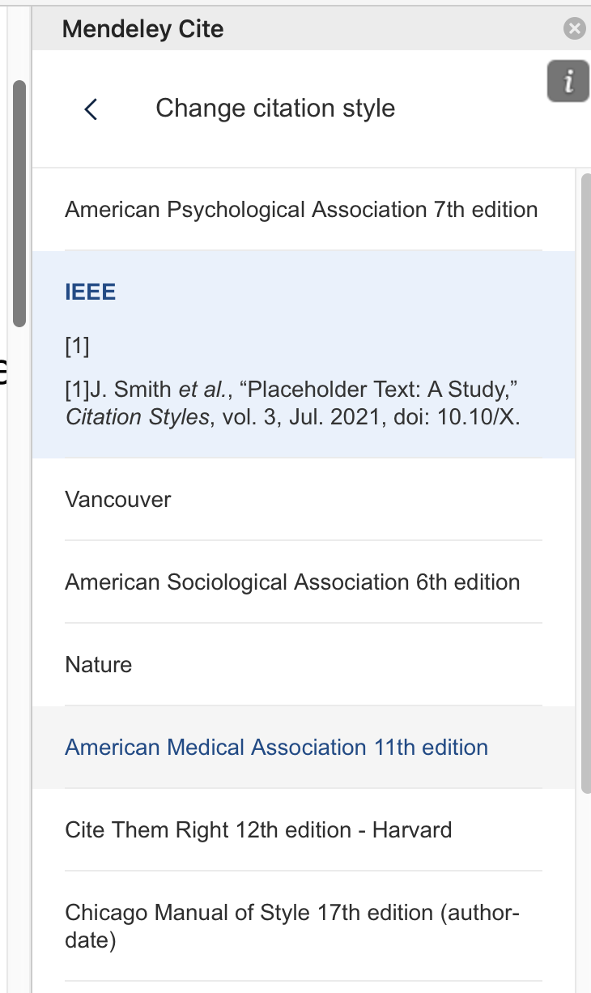
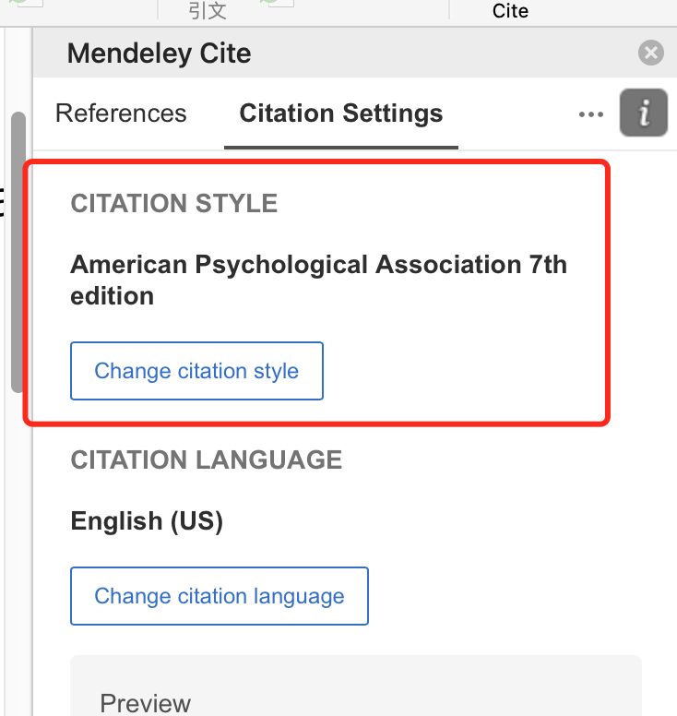

Slide 71
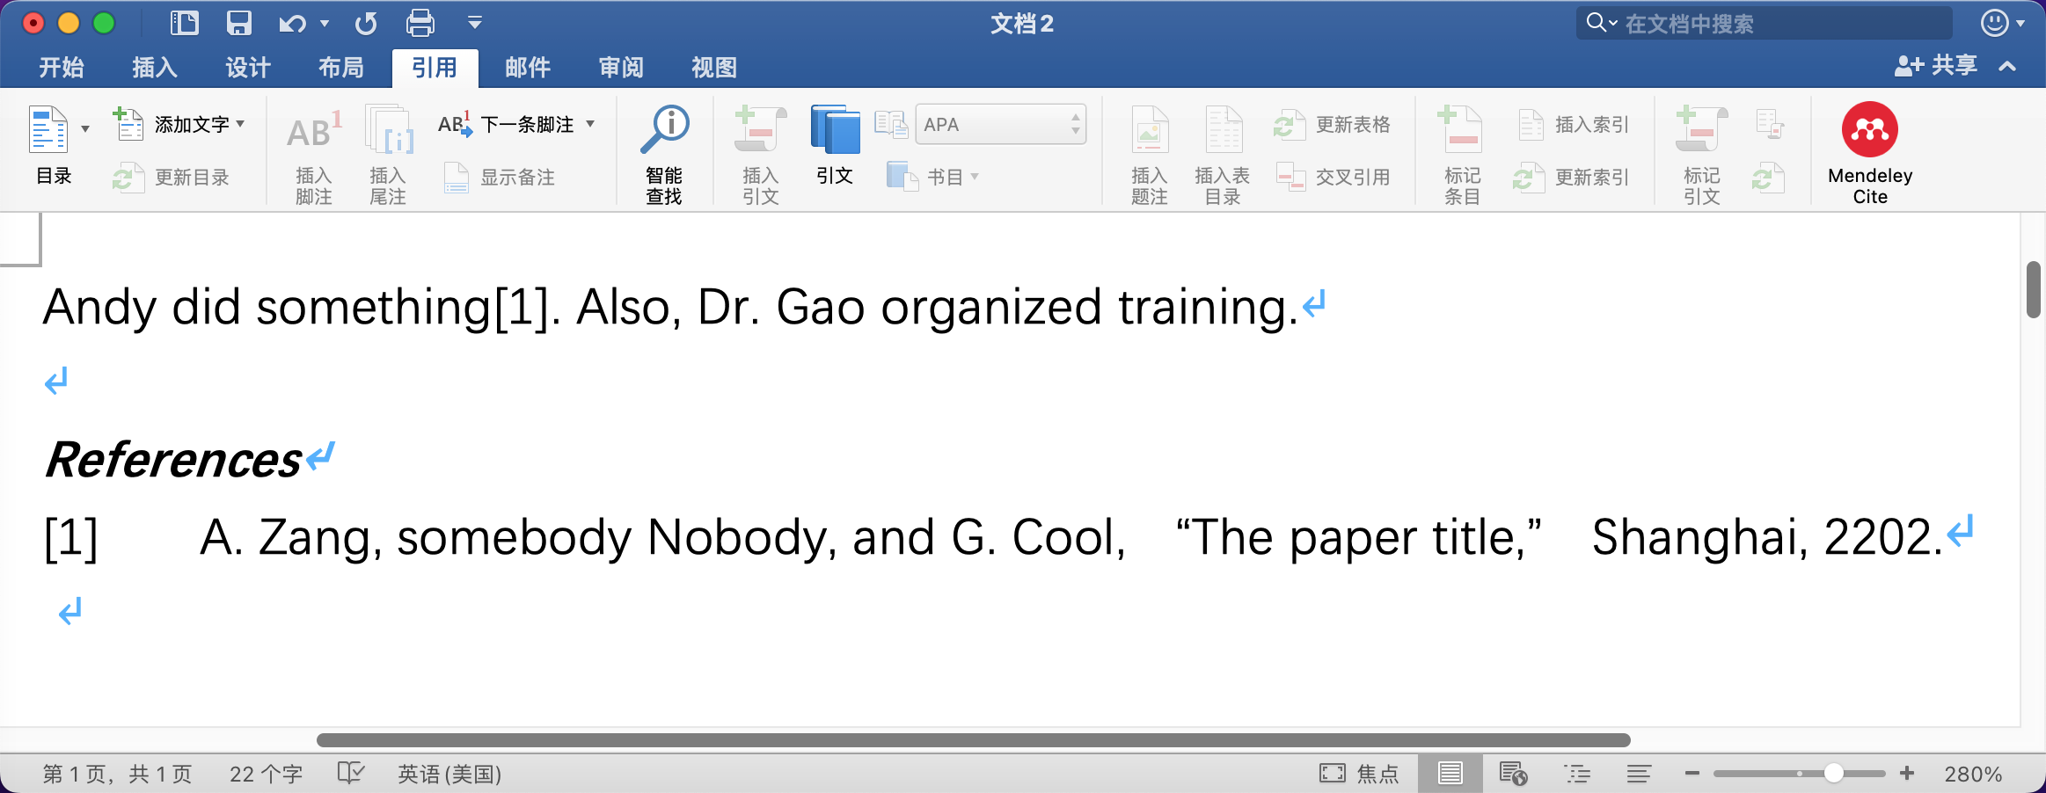

Slide 72
Good luck!

Slide 73


A useful manual

